Slide 1

Salesforce
Declarative Lookup Rollup Summary (DLRS)

Slide 2
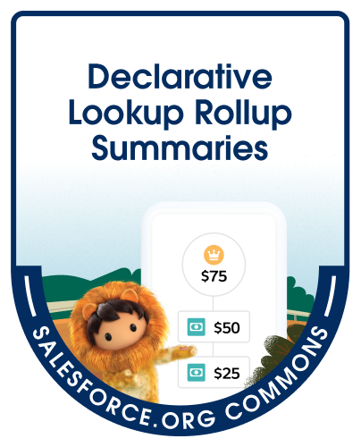
Introduction to DLRS
Salesforce Declarative Lookup Rollup Summary (DLRS) is a powerful tool that allows you to roll up information from related records without writing code. With DLRS, you can create rollup summaries on any object, including custom objects, and perform calculations on the data. This makes it easier to analyze your data and make informed business decisions.

Slide 3
Benefits of DLRS
DLRS provides several benefits for managing data in Salesforce. Some of the key benefits include:
Automated calculations: DLRS allows for automatic rollup calculations, saving time and reducing errors.
Real-time updates: DLRS can be configured to update rollup summaries in real-time, providing up-to-date information for reporting and analysis.
Customizable rollups: DLRS allows for the creation of custom rollup summaries to meet specific business needs.
Reduced data storage: By using rollup summaries, DLRS can help reduce the amount of data stored in Salesforce, improving performance and reducing costs.
Support for multiple child relationships for a single parent object.
Ability to rollup data from grandchild and great-grandchild objects through parent-child relationships.
Support for complex filter criteria to determine which child records to include in the rollup calculation.

Slide 4
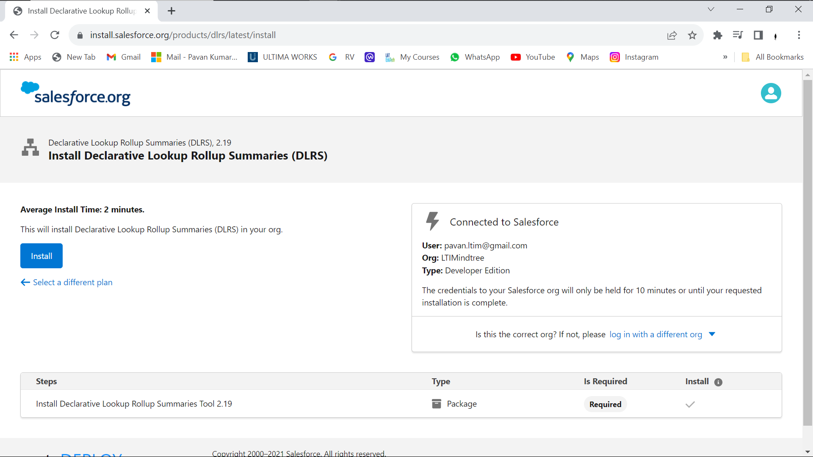
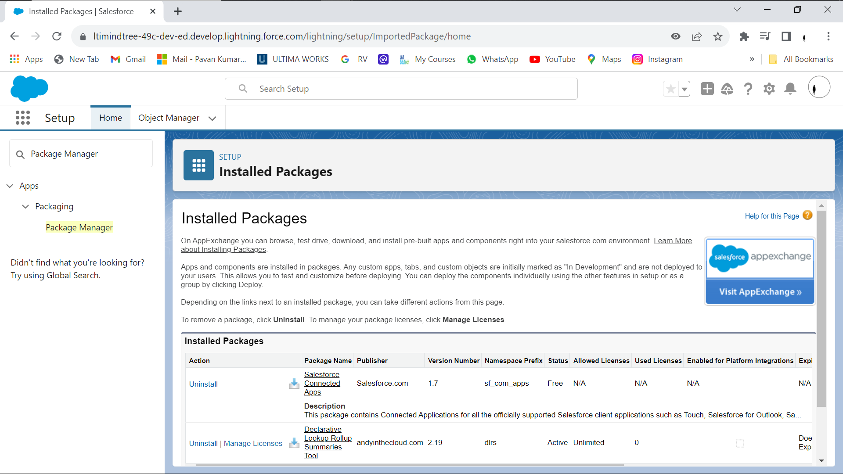
To install DLRS, first make sure that you have a Salesforce account with the necessary permissions. Then, follow these steps: 1. Go to the AppExchange and search for DLRS. 2. Click 'Get It Now' and follow the instructions to install the package. 3. After installation, go to the 'DLRS Settings' tab and configure the settings according to your needs.
Installation and Setup

Slide 5
Creating a Rollup Summary Field
Step 1: Install DLRS Package
First, you need to install the DLRS package from the Salesforce AppExchange.
Step 2: Create a Lookup Relationship
Create a lookup relationship between the parent and child objects.
Step 3: Create a DLRS Definition
Create a new DLRS definition and specify the parent and child objects, as well as the field to be rolled up and the operation to be performed.
Step 4: Schedule the DLRS Calculation
Schedule the DLRS calculation to run at the desired frequency.
Step 5: Display the Rollup Summary Field Once the rollup summary field has been created, we can display it on the parent object's page layout by adding a new custom field of type 'Roll-Up Summary'. We can then select the appropriate rollup summary field and configure any additional display options.

Slide 6
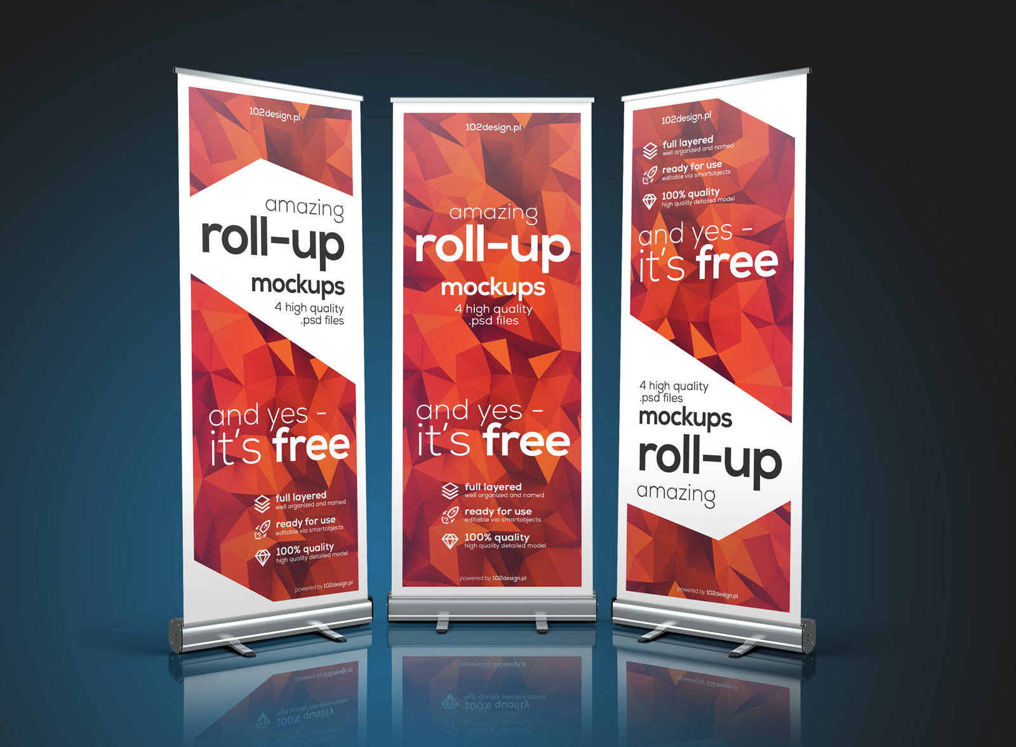

Advanced Features
Real-Time Rollups
DLRS can perform real-time rollups, which means that the rollup fields are updated as soon as the source records are created or edited. This ensures that the data is always up-to-date and accurate.
Lookup Filters
DLRS supports lookup filters, which allow you to filter the source records that are included in the rollup. This is useful when you only want to include certain records in the rollup, such as those that meet specific criteria.

Slide 7


Use Cases
Reporting
DLRS can be used to summarize data for reporting purposes. By rolling up data from child records onto parent records, you can easily generate reports that show a summary of the data at the parent level.
Automation
DLRS can be used to automate certain processes in Salesforce. For example, you can use DLRS to update a field on a parent record based on the values of child records. This can be useful for calculating totals, averages, or other summary data.

Slide 8


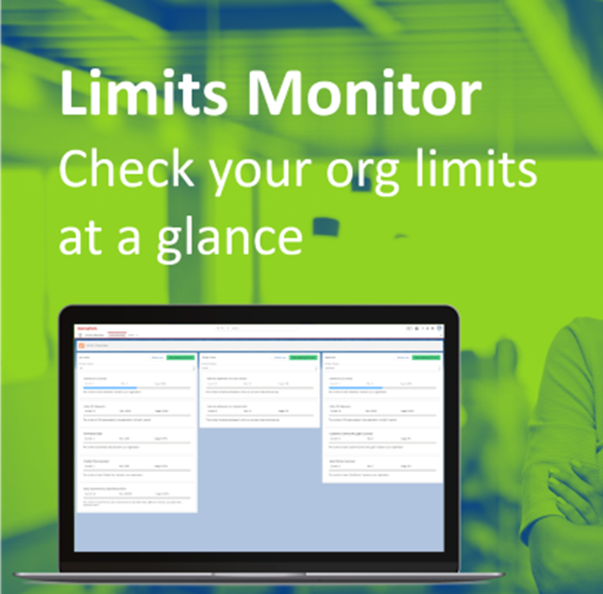
Best Practices
1. Plan Ahead
Before implementing DLRS, take the time to plan out your data model and determine which rollup summaries you need. This will save time and prevent errors in the long run.
2. Use Batch Apex
When dealing with large volumes of data, use Batch Apex to process the rollup summaries. This will prevent timeouts and ensure that the rollups are processed efficiently.
3. Monitor Your Limits
DLRS uses a lot of system resources, so it's important to monitor your limits and adjust your rollup summaries accordingly. Keep an eye on your CPU time and heap size, and consider reducing the number of rollup summaries if necessary.

Slide 9
Conclusion
In conclusion, Salesforce Declarative Lookup Rollup Summary (DLRS) is a powerful tool for automating complex rollup calculations in Salesforce. It provides a user-friendly interface for creating rollup fields and supports a wide range of rollup operations. With DLRS, users can save time and improve data accuracy by automating the rollup process. Additionally, DLRS is highly customizable and can be tailored to meet the specific needs of any organization. We hope this presentation has been informative and helpful in understanding the benefits of DLRS. Thank you for your attention.

Slide 10
Thank You
Thank you for using DLRS! If you have any questions or need further assistance, please visit page at https://install.salesforce.org/products/dlrs/latest

